Slide 1
Stephen Covey's 4 Quadrants
Case Study and Model

Slide 2
https://www.youtube.com/watch?v=DNoQiScnOaA
Quadrant 1 (Urgent and Important): These tasks are critical and need immediate attention. They often include crises, deadlines, and pressing problems. These tasks, if not handled, can lead to significant negative consequences.
Example: A medical emergency or a project due tomorrow.

Slide 3
Quadrant 2 (Not Urgent but Important): These activities focus on long-term goals, planning, and personal growth. Covey emphasizes the importance of spending most time here as it leads to sustainable success and fulfillment.
Example: Exercise, relationship building, and strategic planning.

Slide 4
Quadrant 3 (Urgent but Not Important): These tasks are often interruptions or distractions that feel urgent but don't contribute significantly to your goals. Handling them takes time away from more important matters.
Example: Unnecessary meetings, most phone calls, or minor tasks.

Slide 5
Quadrant 4 (Not Urgent and Not Important): These activities are time-wasters that offer no real value and should be minimized.
Example: Excessive social media scrolling or watching too much TV.

Slide 6
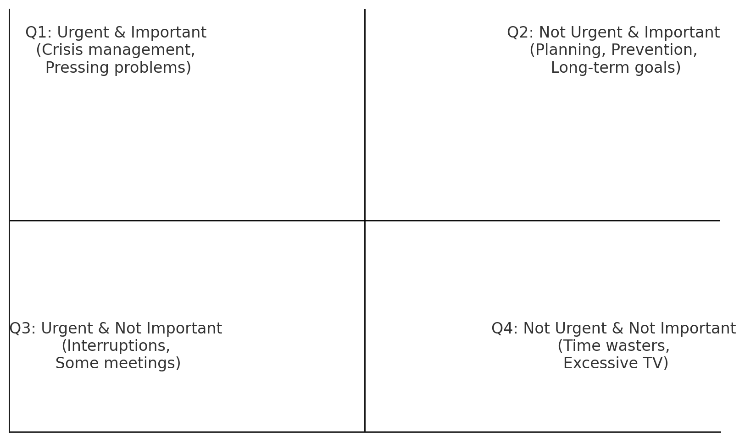
Covey's Time Management Matrix

Slide 7
Case Study: A Manager’s Dilemma
John, a mid-level manager, spends most of his time handling urgent crises and putting out fires (Quadrant 1). Due to constant interruptions (Quadrant 3), he rarely gets time to plan for long-term growth (Quadrant 2). He realizes that by delegating some urgent but less important tasks (Quadrant 3) and limiting time-wasting activities (Quadrant 4), he can focus more on strategic planning and team development (Quadrant 2). Over time, John becomes more proactive, reducing the number of crises (Quadrant 1) and achieving better work-life balance.

